Slide 1
0x404 – Local Variables
ECED4406 – Computer Security
Dr. Colin O’Flynn
Dalhousie University.

Slide 2
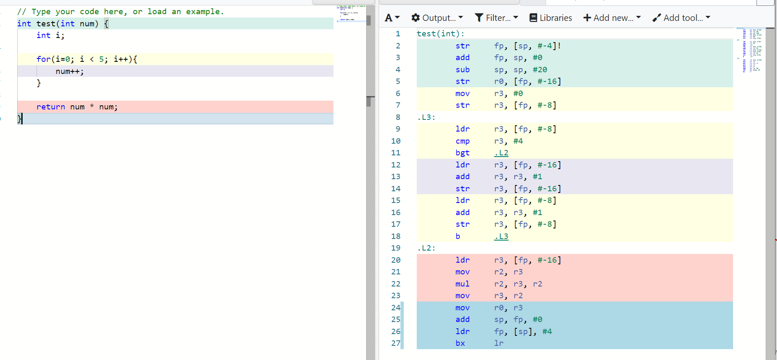
Example of Local Variables

Slide 3
Where do local variables get stored?
Often stored in registers.
May also be stored in memory (RAM), normally when:
Compiler has run out of registers to use.
Variable is declared static (stays around).
Variable is declared volatile.
Compiler feels like it (optimization disabled, other reasons).

Slide 4
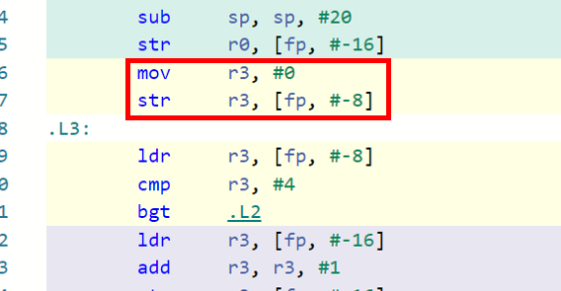
Registers vs. Memory?
The CPU can only perform operations (such as comparisons, additions, etc) on registers.
Therefor all variables will get moved from memory into registers when used.
Set r3 to 0, then store to address [fp, #-8]
Load from address [fp, #-8] into r3

Slide 5
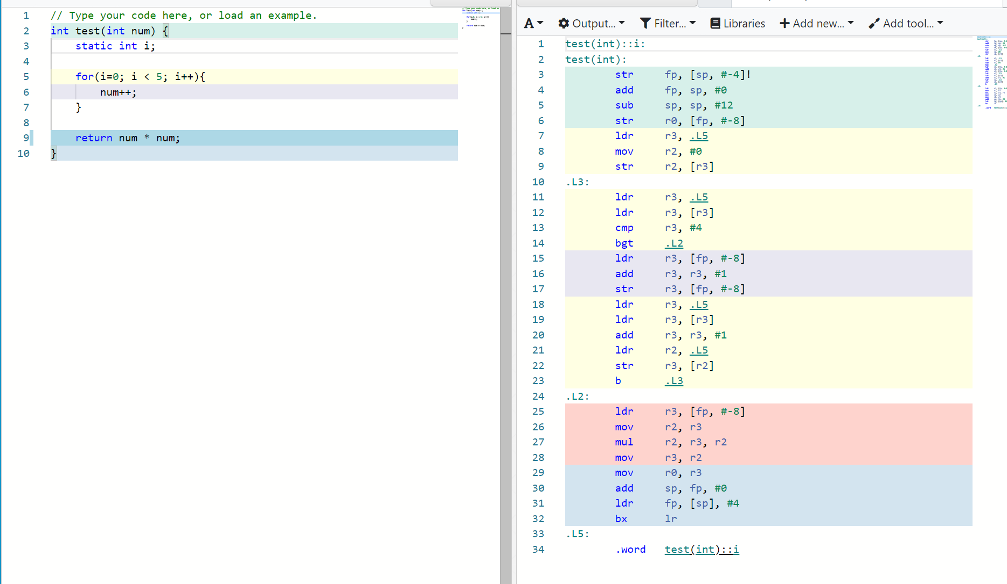
Stack vs. Static
Define variable static -> now stored at some specific location.

Slide 6
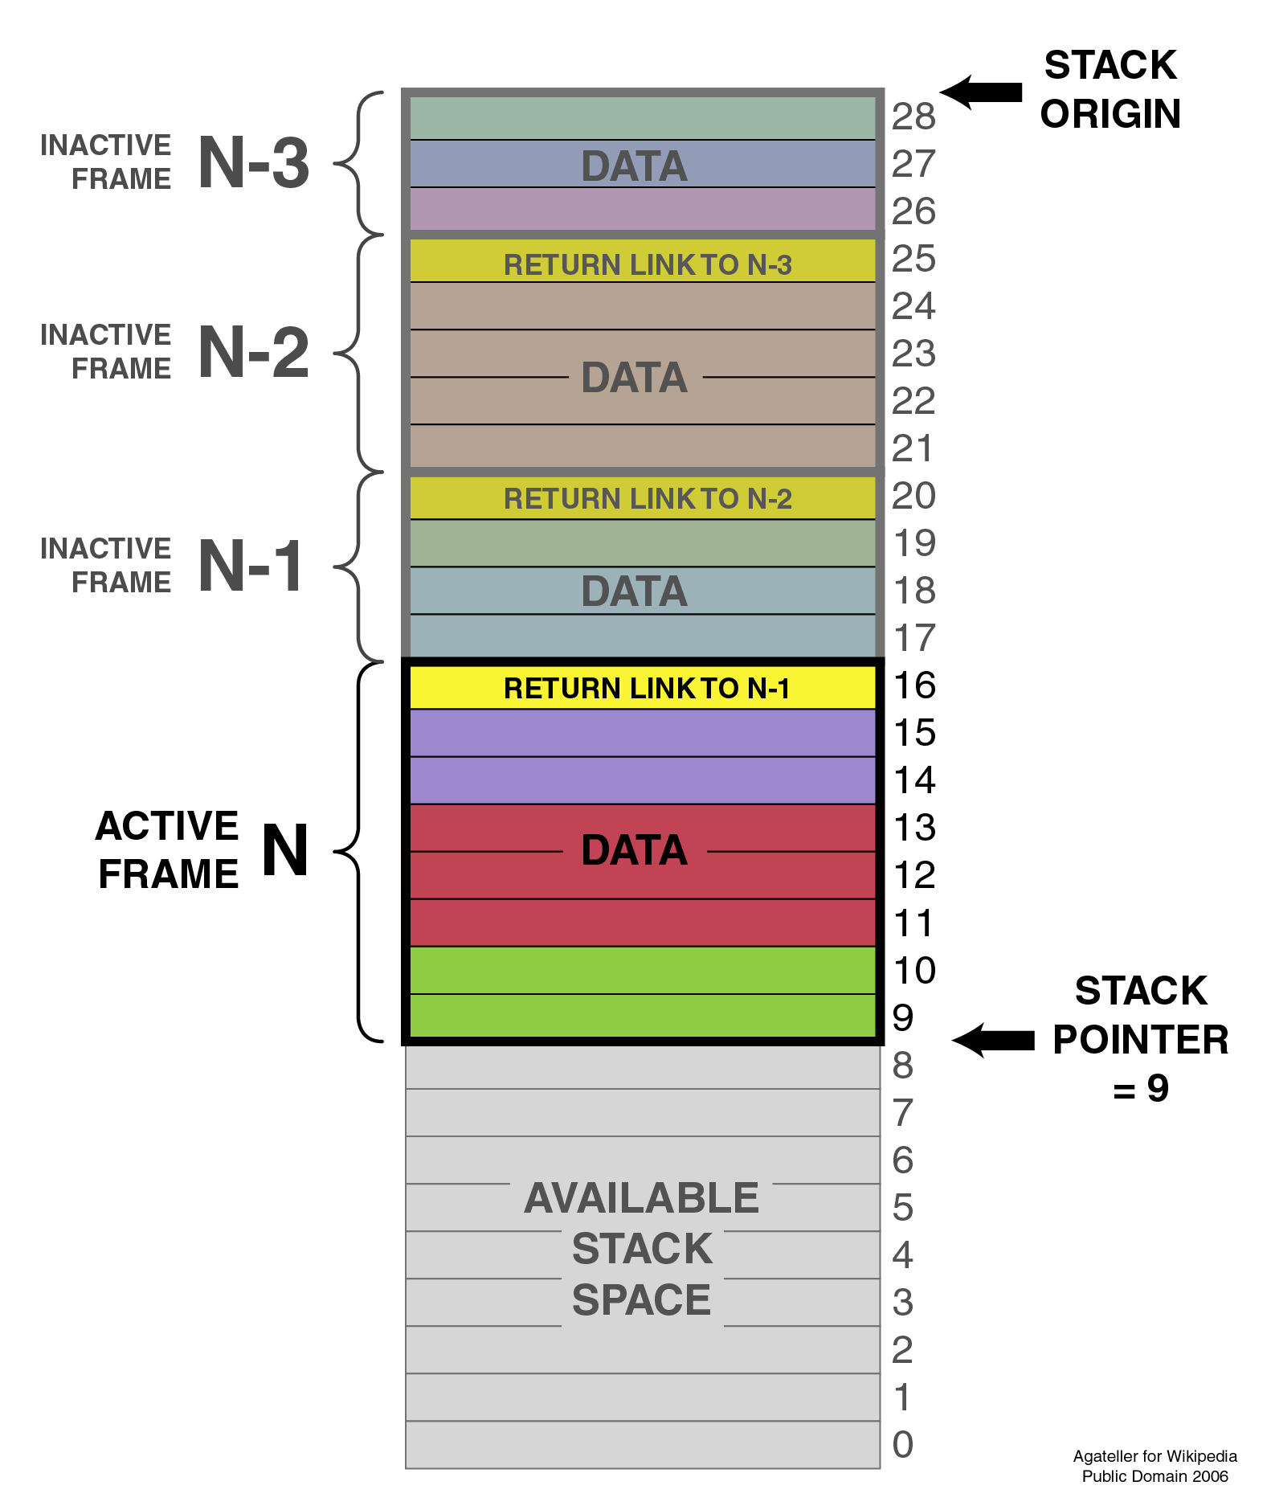
What was this [fp, #-8] thingy?
fp = “Frame Pointer”

Slide 7
Variables in Functions
CPU only functions on registers.
When tracking where in memory things are stored – may need to look back a little to see if load/store happens.
Local variables are stored on the stack frame – this will be reused in other functions.
Global or static variables are stored at a specific location in memory (and never re-used).

